Slide 1
Concepts of Boolean Algebra

Slide 2
Lecture 15 Boolean Analysis of Logic Circuits
Lecture delivered by:
Deepak V.

Slide 3
Topics
Boolean Analysis of Logic Circuits
Constructing a Truth Table for a Logic Circuit

Slide 4
Objectives
At the end of this lecture, student will be able to:
Acquire the knowledge Boolean Analysis of Logic Circuits
Compile a Truth Table for a Logic Circuit

Slide 5
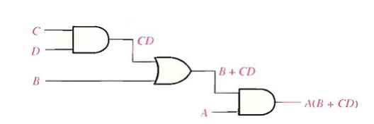
Boolean Analysis of Logic Circuits
Boolean algebra provides a concise way to express the operation of a logic circuit formed by a combination of logic gates so that the output can be determined for various combinations of input values.
Figure: A logic circuit showing the development of the Boolean expression for the output

Slide 6
Boolean Analysis of Logic Circuits
To derive the Boolean expression for a given logic circuit, begin at the leftmost inputs and work toward the final output
The Boolean expression is determined as follows:
The expression for the left-most AND gate with inputs C and D is CD
The output of the left-most AND gate is one of the inputs to the OR gate and B is the other input. Therefore, the expression for the OR gate is B + CD
The output of the OR gate is one of the inputs to the right-most AND gate and A is the other input. Therefore, the expression for this AND gate is
A(B + CD), which is the final output expression for the entire circuit.

Slide 7
Constructing a Truth Table for a Logic Circuit
Once the Boolean expression for a given logic circuit has been determined, a truth table that shows the output for all possible values of the input variables can be developed
By considering the previous circuit as the example
A(B+CD)
There are four variables, hence 16 (2⁴) combinations of values are possible

Slide 8
Constructing a Truth Table for a Logic Circuit
Evaluating the expression
To evaluate the expression A(B+CD), first find the values of the variables that make the expression equal to 1 (using the rules for Boolean add & mult)
In this case, the expression equals 1 only if A=1 and B+CD=1 because
A(B+CD) = 1·1 = 1

Slide 9
Constructing a Truth Table for a Logic Circuit
Evaluating the expression (cont’)
Now, determine when B+CD term equals 1.
The term B+CD=1 if either B=1 or CD=1 or if both B and CD equal 1 because
B+CD = 1+0 = 1
B+CD = 0+1 = 1
B+CD = 1+1 = 1
The term CD=1 only if C=1 and D=1

Slide 10
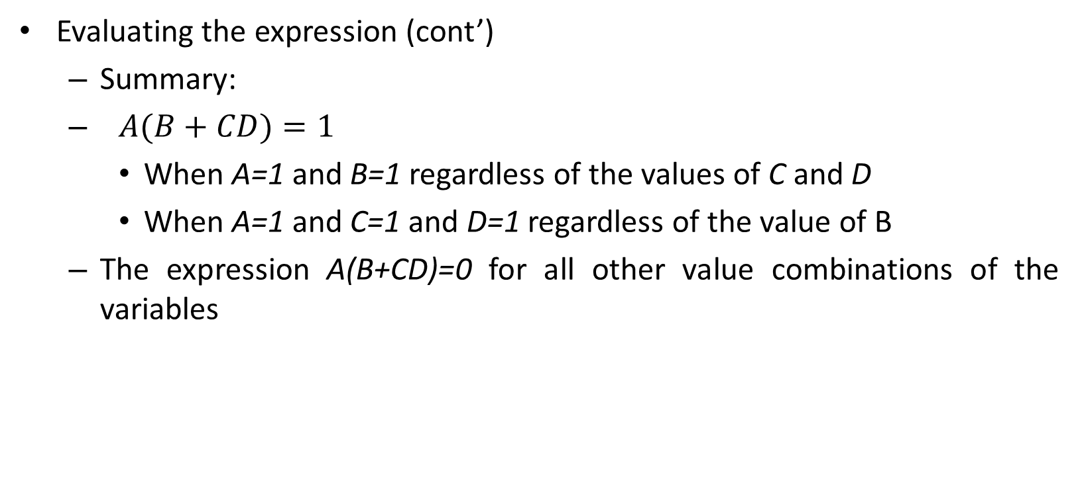
Constructing a Truth Table for a Logic Circuit
Evaluating the expression (cont’)
Summary:
$A(B+CD)=1$
When A=1 and B=1 regardless of the values of C and D
When A=1 and C=1 and D=1 regardless of the value of B
The expression A(B+CD)=0 for all other value combinations of the variables

Slide 11
Constructing a Truth Table for a Logic Circuit
INPUTS |  |  |  | OUTPUT
A | B | C | D | A(B+CD)
0 | 0 | 0 | 0 | 0
0 | 0 | 0 | 1 | 0
0 | 0 | 1 | 0 | 0
0 | 0 | 1 | 1 | 0
0 | 1 | 0 | 0 | 0
0 | 1 | 0 | 1 | 0
0 | 1 | 1 | 0 | 0
0 | 1 | 1 | 1 | 0
1 | 0 | 0 | 0 | 0
1 | 0 | 0 | 1 | 0
1 | 0 | 1 | 0 | 0
1 | 0 | 1 | 1 | 1
1 | 1 | 0 | 0 | 1
1 | 1 | 0 | 1 | 1
1 | 1 | 1 | 0 | 1
1 | 1 | 1 | 1 | 1
Putting the results in truth table format
A(B+CD)=1
When A=1 and B=1 regardless of the values of C and D
When A=1 and C=1 and D=1 regardless of the value of B

Slide 12
Contd..
TRUTH TABLE FOR F₁=xyz’, F₂=x+y’z, F₃=x’y’z+x’yz+xy’ and F₄=xy’+x’z
x | y | z | F1 | F2 | F3 | F4
0 | 0 | 0 | 0 | 0 | 0 | 0
0 | 0 | 1 | 0 | 1 | 1 | 1
0 | 1 | 0 | 0 | 0 | 0 | 0
0 | 1 | 1 | 0 | 0 | 1 | 1
1 | 0 | 0 | 0 | 1 | 1 | 1
1 | 0 | 1 | 0 | 1 | 1 | 1
1 | 1 | 0 | 1 | 1 | 0 | 0
1 | 1 | 1 | 0 | 1 | 0 | 0

Slide 13
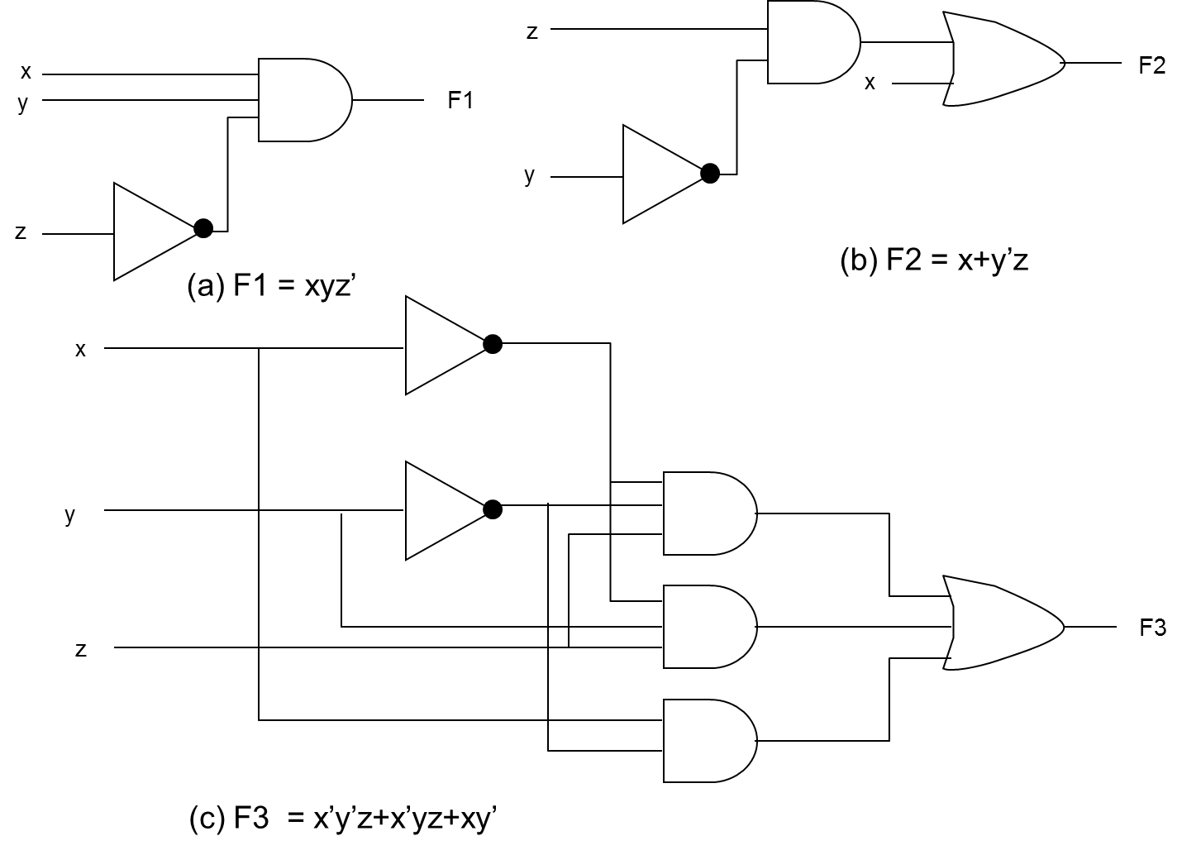
Contd..

Slide 14
Contd..
x
y
F4
(c) F4 = xy’+x’z
z
Implementation of Boolean Function with GATES

Slide 15
Summary
Boolean algebra provides a concise way to express the operation of a logic circuit formed by a combination of logic gates
Once the Boolean expression is determined, a truth table can be developed

